Slide 1
TOPIC
COMPANY LAW
Submitted To:- Shashwat Singhal
Submitted By:- Unnati Chaurasia

Slide 2
INTRODUCTION
Company Law is a branch of law that regulates the formation, incorporation, management, and winding up of companies. It provides a legal framework for the operation of businesses and defines the rights, duties, and responsibilities of directors, shareholders, creditors, and other stakeholders.
In India, Company Law is primarily governed by the Companies Act, 2013, which aims to promote transparency, accountability, and good corporate governance and it also divided into 29 Chapters,470 Sections/Rules, 7 Schedules. It ensures that companies conduct their business activities in accordance with legal provisions and protects the interests of investors and the public.

Slide 3
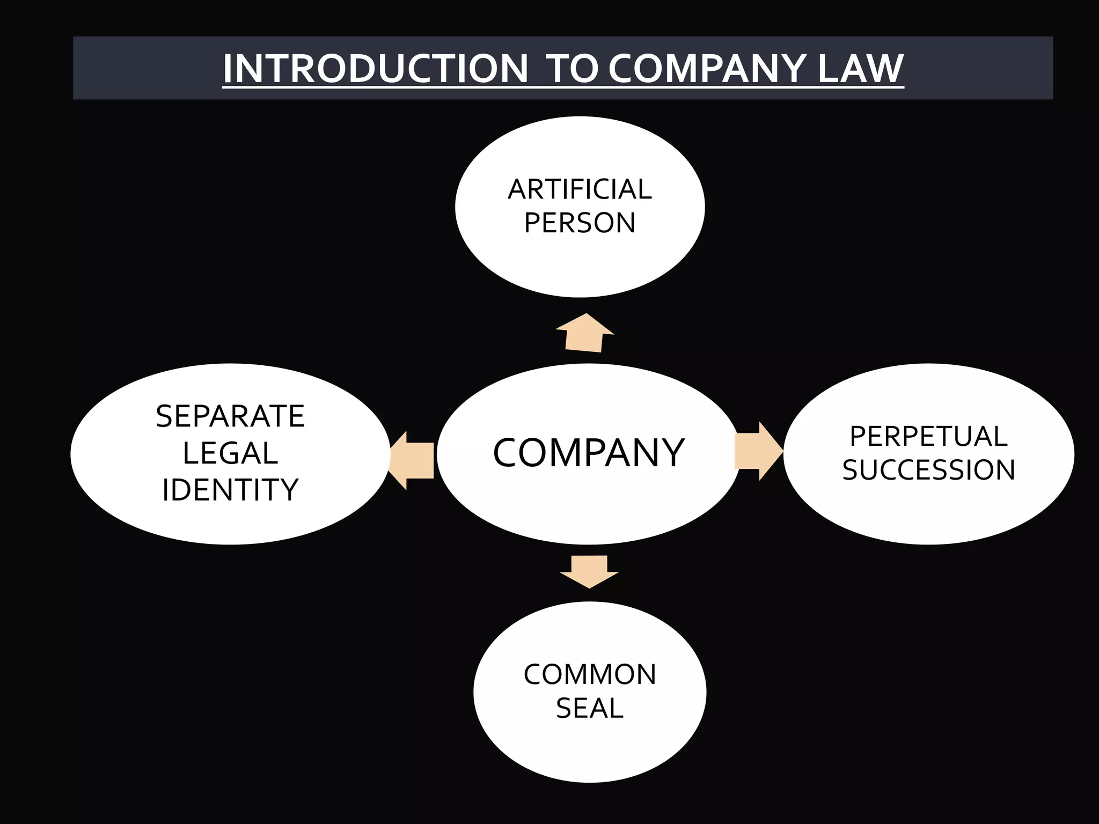
FEATURES OF COMPANY LAW
Separate Legal Entity
Perpetual Succession
Limited Liability
Common Seal (optional)
Transferability of Shares

Slide 4
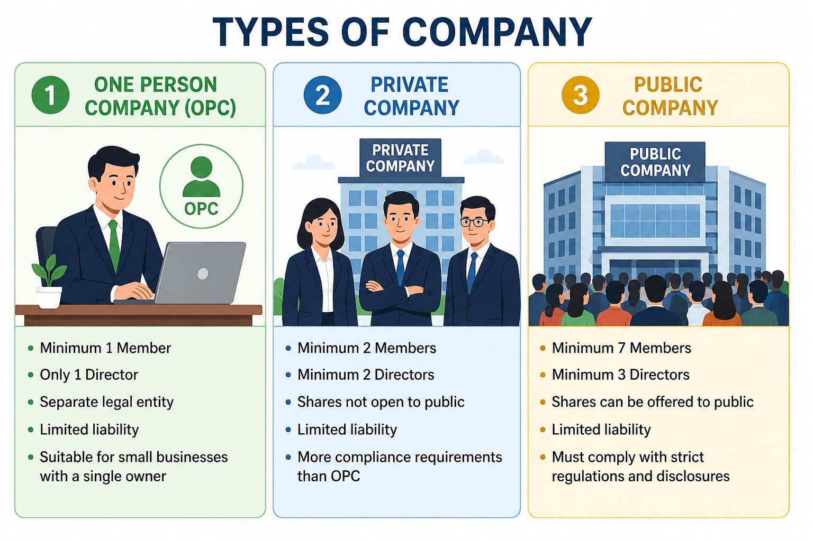
TYPES OF COMPANY LAW
(OPC) One Person Company: 1 Director
Private Company: 2 Directors
Public Company: 3 Directors
Maximum: 15 Directors (more with Special Resolution)

Slide 5
INCORPORATION OF A COMPANY
Obtain Digital Signature Certificate (DSC)
Apply for Director Identification Number (DIN)
Reserve Company Name
File Incorporation Documents
Receive Certificate of Incorporation

Slide 6
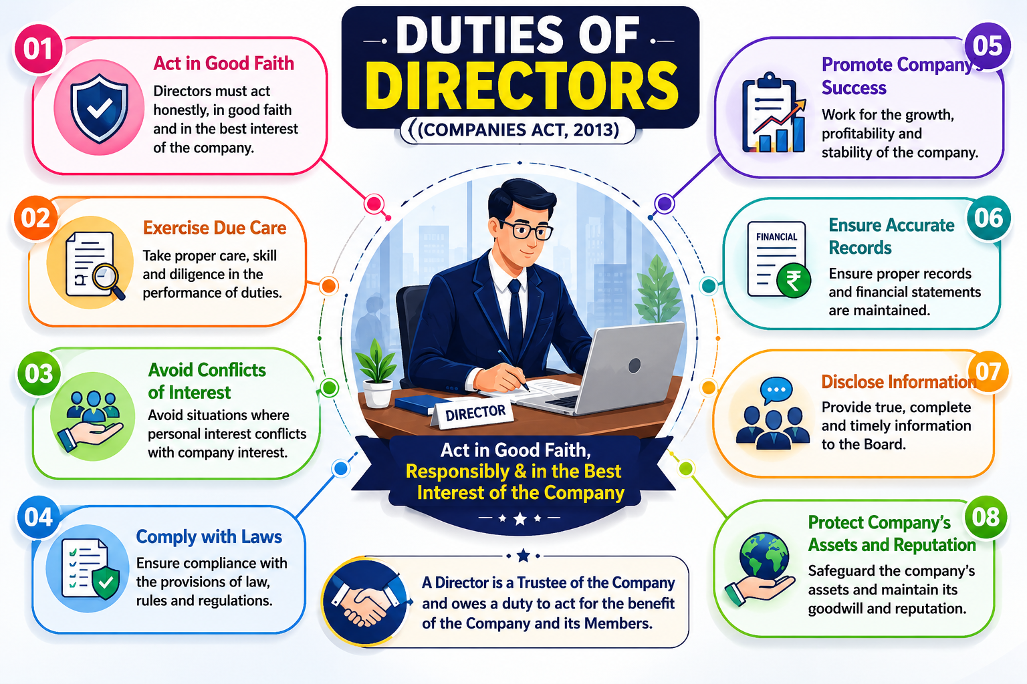
DIRECTORS OF A COMPANY
A Director is a person appointed to manage and oversee the affairs of a company. Directors are responsible for making important business decisions and ensuring that the company complies with legal requirements. No. of Directors in a company are 15 and more than 15 Directors can be appointed by passing a Special Resolution.
Duties of Directors
Act in good faith.
Ensure compliance with laws.
Protect company assets.
Avoid conflicts of interest.
Maintain transparency.

Slide 7
REGIONAL DIRECTORS
A Regional Director (RD) is a senior officer appointed by the Ministry of Corporate Affairs (MCA) to represent the Central Government in matters related to company administration. The Regional Director supervises the functioning of the Registrar of Companies (ROC) and ensures compliance with the provisions of the Companies Act, 2013 within a specified region.
The Regional Director plays an important role in corporate regulation, handling approvals, appeals, inspections, and other matters delegated by the Central Government.

Slide 8
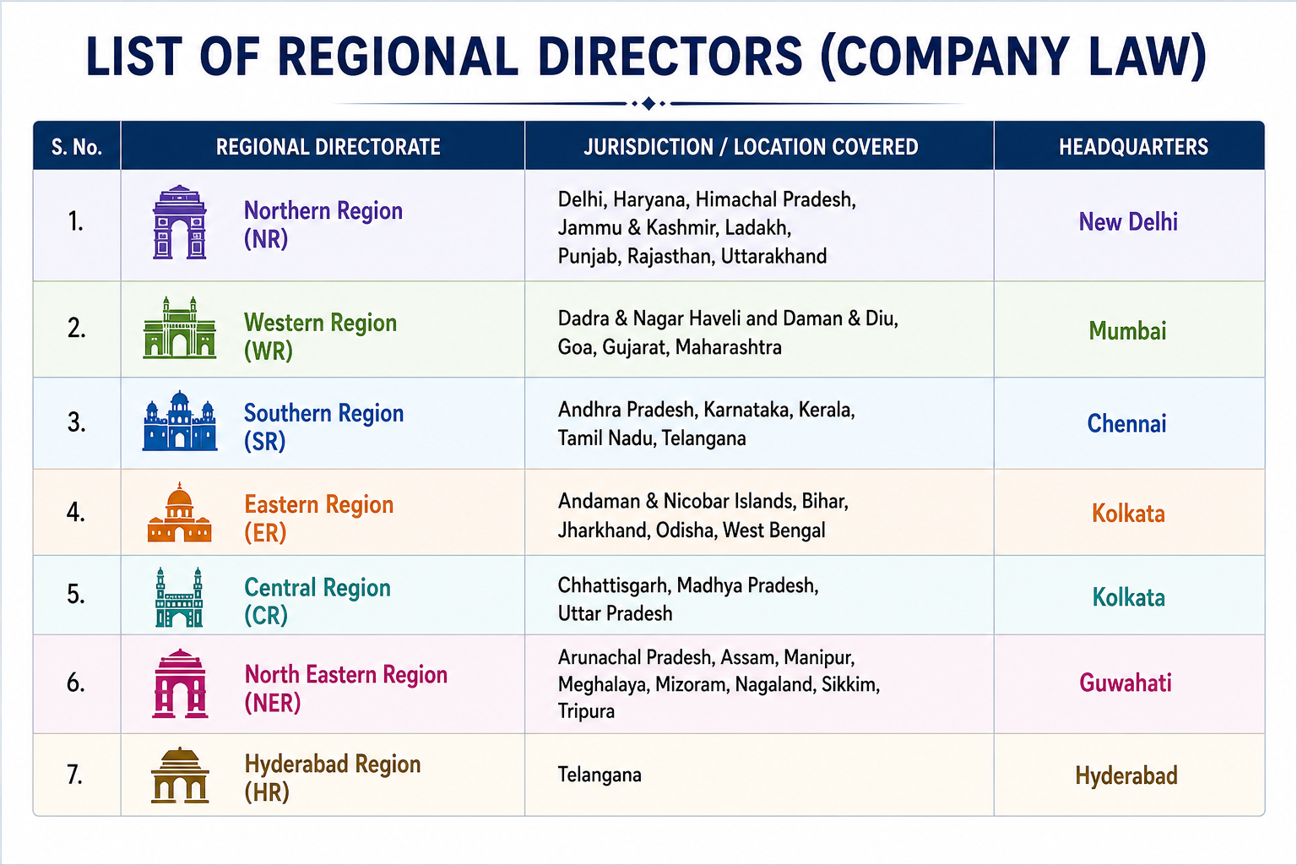
List of Regional Directors' Headquarters
New Delhi (Northern Region I)
Chandigarh (Northern Region II)
Ahmedabad (North-Western Region)
Mumbai (Western Region I)
Navi Mumbai (Western Region II)
Chennai (Southern Region)
Bangalore (South-Western Region)
Kolkata (Eastern Region)
Guwahati (North-Eastern Region)
Hyderabad (South-Eastern Region)

Slide 9
MEETINGS IN COMPANY LAW
Meetings are an essential part of company management and governance. They provide a platform for directors and shareholders to discuss company matters, make decisions, and ensure smooth functioning of the organization. The Companies Act, 2013 lays down rules regarding the conduct, notice, quorum, and proceedings of meetings to ensure transparency and proper decision-making.

Slide 10
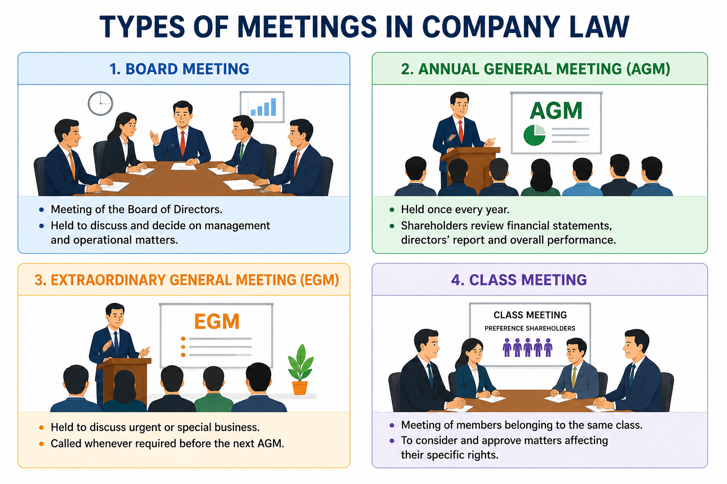
Types of Meetings:-
Board Meeting :-
  Meeting of the Board of Directors.
  Discusses management and operational decisions.
Annual General Meeting (AGM) :-
  Held once every year.
  Shareholders review financial statements and company performance.
Extraordinary General Meeting (EGM) :-
  Held to discuss urgent or special business matters.
  Called when required before the next AGM.
Class Meeting :-
  Meeting of a particular class of shareholders.
  Discusses matters affecting their specific rights.

Slide 11
CONCLUSION
Company Law provides the legal framework for the formation, management, and regulation of companies. It ensures transparency, accountability, and protection of stakeholders' interests. Through provisions relating to directors, meetings, Regional Directors, and corporate governance, the Companies Act, 2013 helps companies operate efficiently and in compliance with the law. Overall, Company Law plays a vital role in promoting responsible business practices and supporting economic growth.

